Slide 1


Mmerichukwu Anosike
BUSINESS FUNDAMENTALS IN TECH
mmerichukwuanosike@gmail.com
@mmerichukwu

Slide 2



02
Intro
duction
HI, AM MMERICHUKWU ANOSIKE
WHAT I DO
Work Experiences
Switch Gas and Ltd
|
Business Developer
Roarnotes
|
Web Developer
Side Hustle UNN
Campus Ambassador
mmerichukwuanosike@gmail.com

Slide 3

04
Solving the customers problems ?
The
Problem
What pains can you solve for your customer with the your skill ?
How best do your understand customers ?
hi@hanihusam.com
@bapak2developer

Slide 4
03
TECH STUDY CASE
hi@hanihusam.com
@bapak2developer

Slide 5
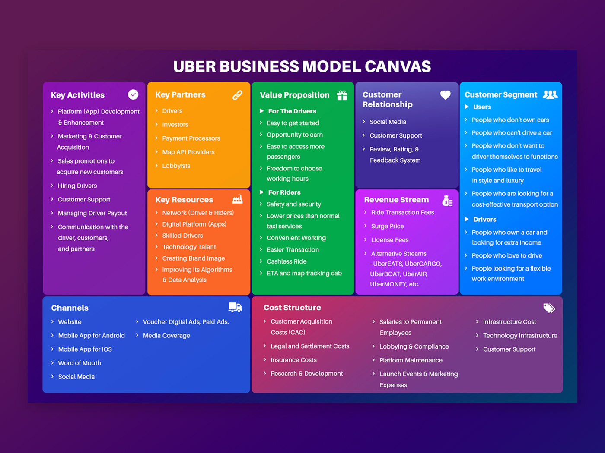

Slide 6
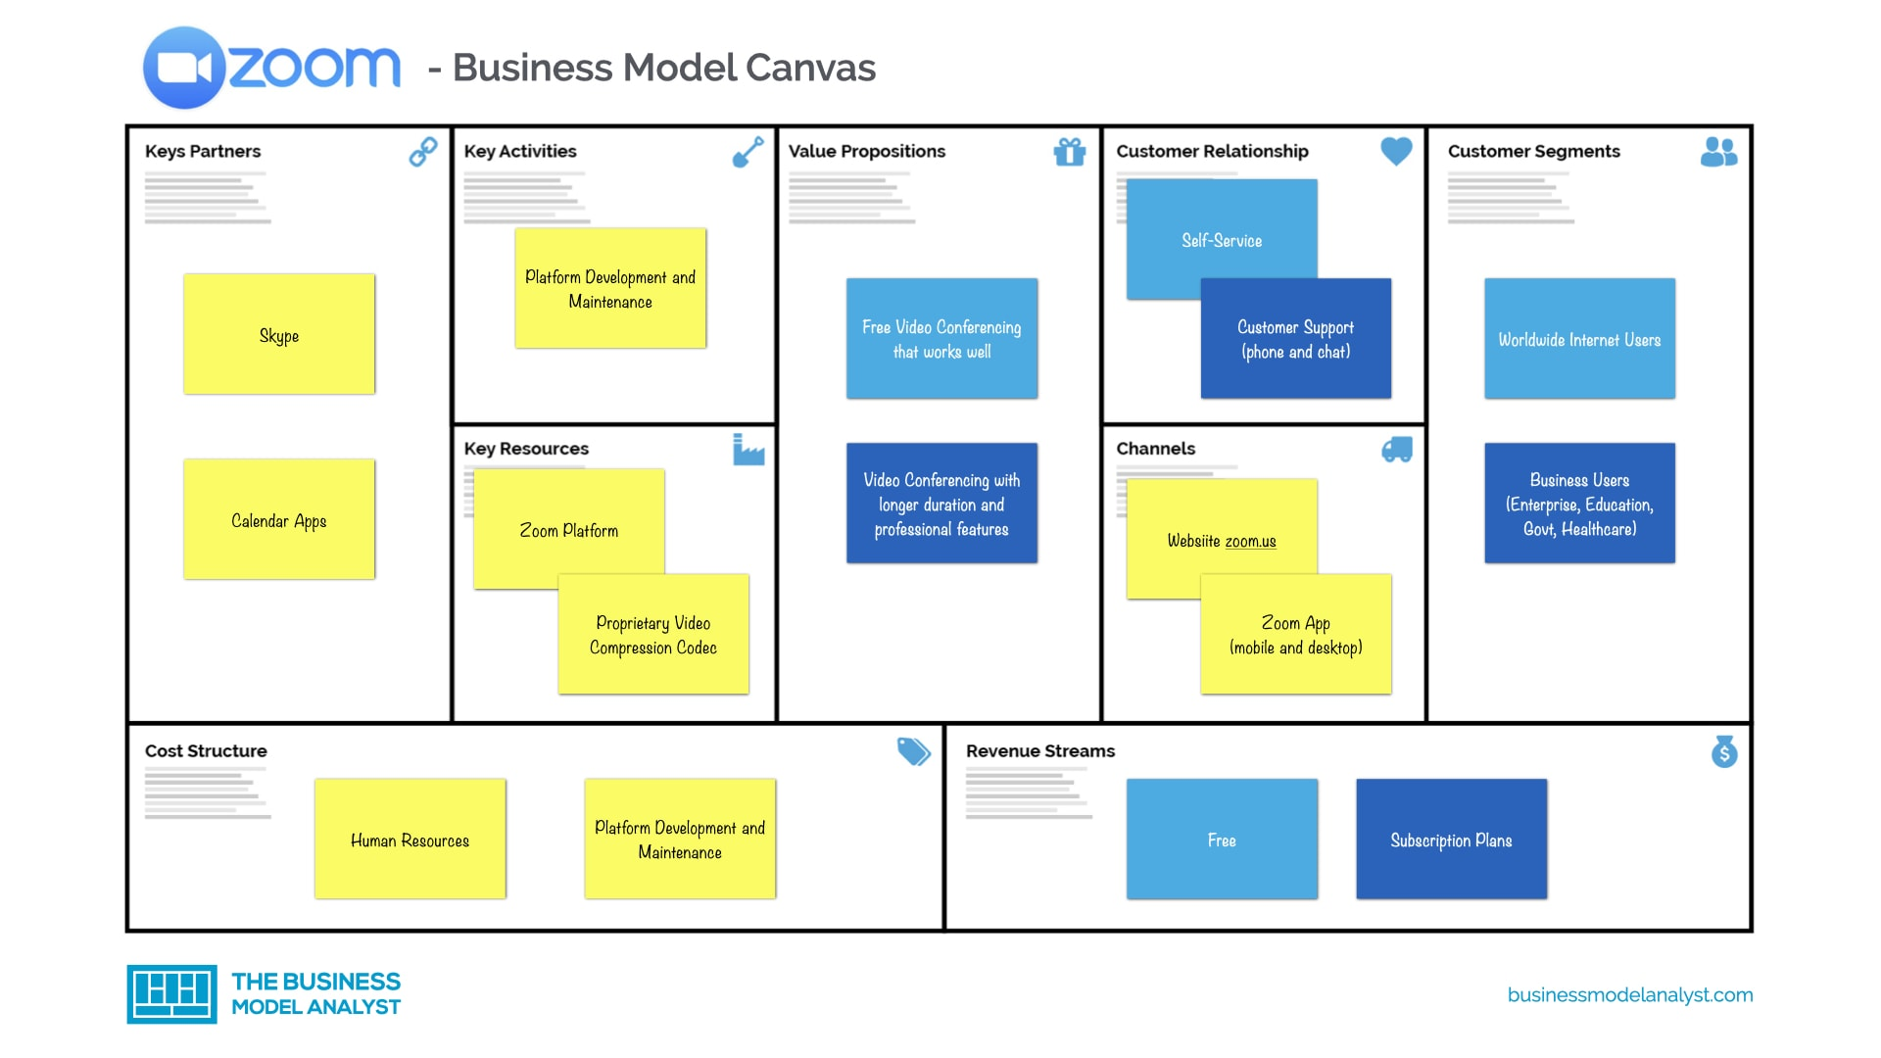

Slide 7






05
Our
Solutions
WordPress
Paid Template
SEO Plugins
Using a WordPress CMS to make it easy for admins to manage content.
Purchase a website template that is then customized to reflect the company brand in order to make it more effective and efficient.
Installing SEO tools in WordPress to support SEO needs.
hi@hanihusam.com
@bapak2developer

Slide 8



06
Resources
Needed
01
Domain and hosting
02
Official company brand assets
03
Content that will be published
hi@hanihusam.com
@bapak2developer

Slide 9




07
Time Schedule
Ticket
Day Estimate
Gathering requirements
2 Days
Non-working Days
I follow the Indonesian’s national public holiday. This public holiday will not be charged to your invoices.
Setup domain and hosting
2 Days
WordPress setup and installing tools
3 Days
Available Time
I am reachable within 09.00 - 18.00 (for communication purposes) on GMT +7 Jakarta Time Timezone.
Company Website (3 pages)
6 Days
Finishing
3 Days
hi@hanihusam.com
@bapak2developer

Slide 10




08
Pricing
Ticket
Estimated Cost
USD
The following is the estimated cost of the proposed project.
Infrastructure Setup
250.00
Website Development
350.00
Total
600.00
hi@hanihusam.com
@bapak2developer

Slide 11






09
Down Payment
We accept a 30% down payment at the start of work.
Payment
Terms
Mid Term
A further 50% is due no later than 10 working days after the website is operational.
Final Term
The remaining payment must be made within 10 working days of the completion of all tickets.
Additional
If there are any extra features, they will be charged starting at 150K.
hi@hanihusam.com

Slide 12



Thanks
Could we be a match? Let’s discuss further.
ANOSIKE MMERICHUKWU
Website Developer

